Slide 1
Intent-Aware Semantic Query Annotation
Author: Rafael Glater, Rodrygo L. T. Santos, Nivio Ziviani
Source: SIGIR’17
Advisor: Jia-Ling Koh
Speaker: BOWEN CHIANG
Date: 2018/5/29

Slide 2
Outline
Introduction
Method
Experiment
Conclusion

Slide 3
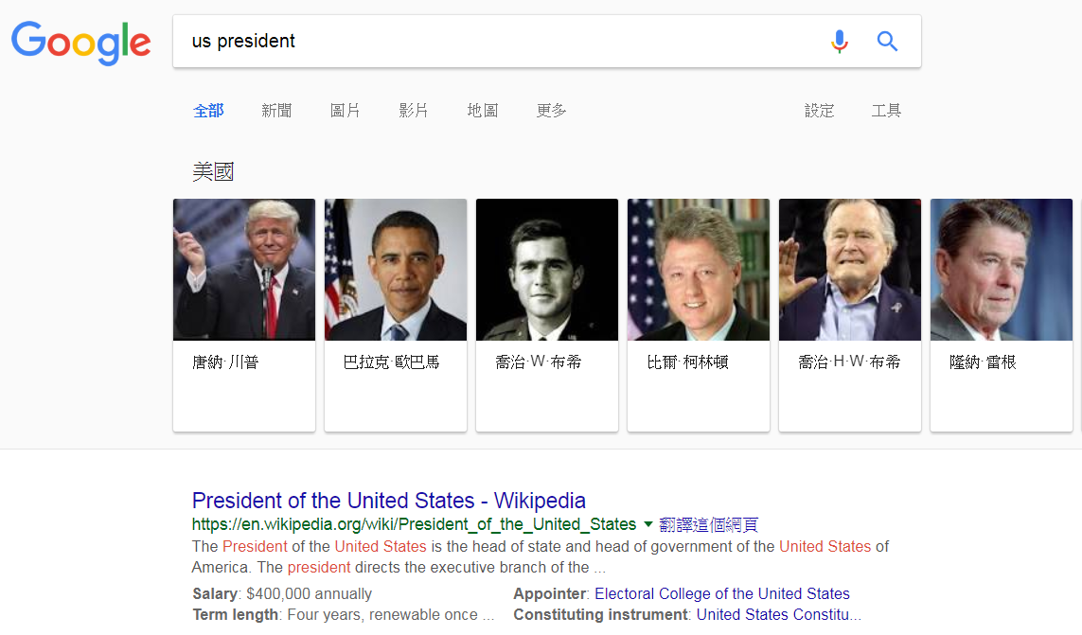
Introduction
Motivation

Slide 4
Introduction
Goal
To automatically annotate a query with semantic resources mined from a knowledge base, including named entities, attributes, relations, etc.
Intent-Specific Semantic Query Annotation
Example
Query “us president”
Semantic resources “Donald Trump”, “Federal Government”, “White House.”

Slide 5
Introduction
Example
Query “us president”
Semantic resources “Donald Trump”, “Federal Government”, “White House.”
Query Intent
E: entity queries
(e.g., “Michael Jackson”)
T: type queries
(e.g., “continents in the world”)
Q: question queries
(e.g., “who created Wikipedia?”)
O: queries with other intents

Slide 6
Outline
Introduction
Method
Experiment
Conclusion

Slide 7
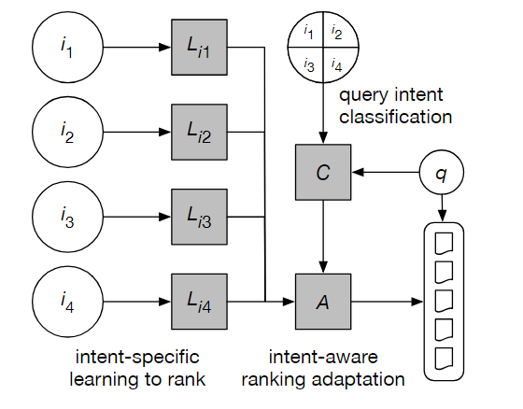
Method
Framework
Query intent classification C
Intent-specific ranking model L_{i}
Intent-aware ranking adaptation
strategy A
Figure 1: Intent-aware semantic query annotation.

Slide 8
Method
Define

Slide 9
Method
Query intent classification C
C: X → Y
Input space X comprises m learning instances
output space Y comprises m labels {y}
y corresponds to one of the target intents i ∈ I

Slide 10
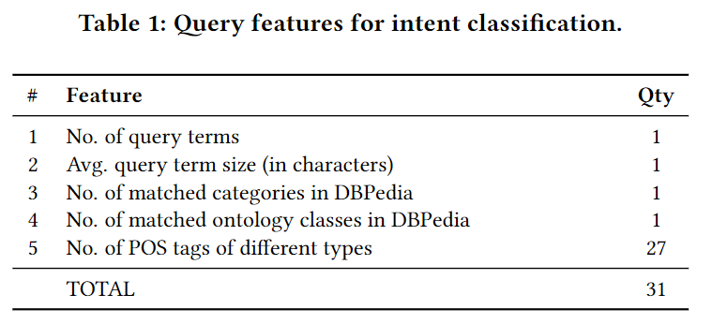
Query intent classification
Feature
3-4
Eiffel
Notes:
http://dbpedia.org/page/Category

Slide 11
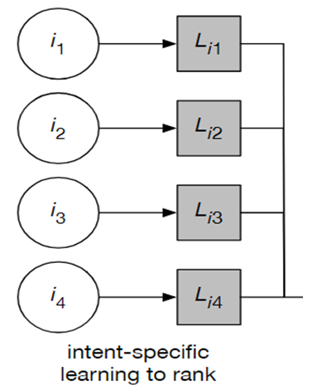
Method
Intent-specific ranking model
Ranking models L_{i}：V→W
Each L_{i} optimized for a specific query intent i ∈ I
Input space V includes n learning instances
Output space W comprises n label vectors {W}
W_{j} provides relevance labels for each semantic resource r ∈ R_{j} .

Slide 12
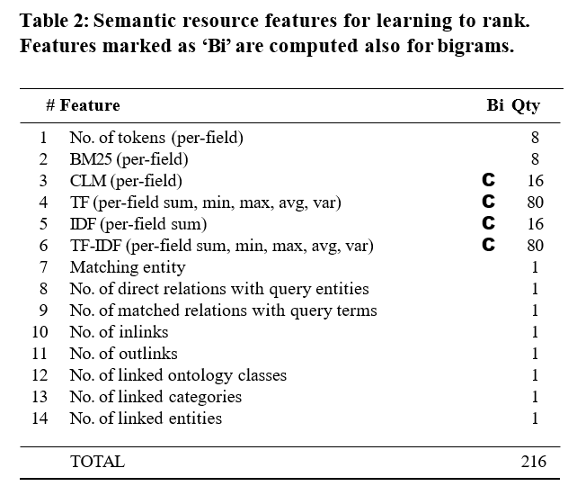
Feature
8 fields :
Names, Attributes, Categories,
Similar entity names,
Related entity names,
Ontology classes,
URL and All

Slide 13
Method
Figure 1: Intent-aware semantic query annotation.

Slide 14
Method
Intent-aware ranking adaptation strategy A
1. Intent-aware switching
EX: intents I = {i₁, i₂, i₃} ,
P(i₁ |q) = 0.7, P(i₂ |q) = 0.2, P(i₃ |q) = 0.1
As a result, only would have an impact on the final ranking
=>

Slide 15
Method
Intent-aware ranking adaptation strategy A
2. Intent-aware mixing
EX: intents I = {i₁, i₂, i₃} ,
P(i₁ |q) = 0.7, P(i₂ |q) = 0.2, P(i₃ |q) = 0.1.
=>
P(r |q) = 0.7 × P(r |q, i₁ )
+ 0.2 × P(r |q, i₂ )
+ 0.1 × P(r |q, i₃ ).

Slide 16
Outline
Introduction
Method
Experiment
Conclusion

Slide 17
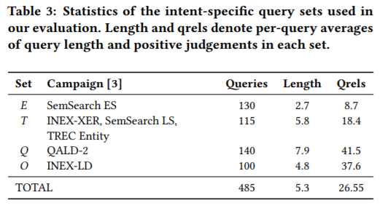
Experiment
Data Set

Slide 18
Experiment
Knowledge base: DBPedia
Extracted from Wikipedia dumps generated in late July 2011
More than 3.6 million entities
Over 170,000 categories and 320 ontology classes in a 6-level deep hierarchy

Slide 19
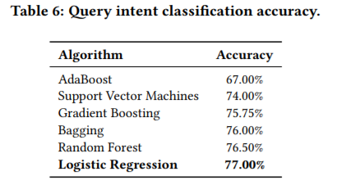
Experiment

Slide 20
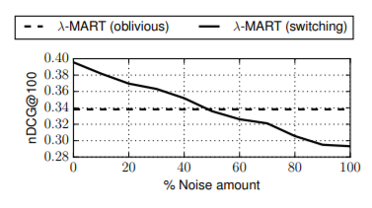
Experiment
Figure 3: Semantic query annotation robustness for simulated intent classifiers of a range of accuracy levels.

Slide 21
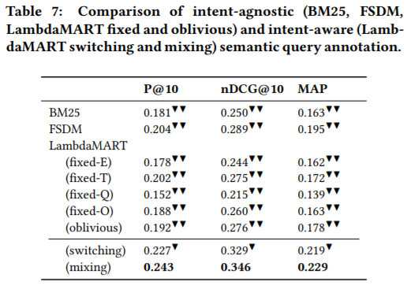
Annotation Effectiveness

Slide 22
Outline
Introduction
Method
Experiment
Conclusion

Slide 23
Conclusion
Main contributions are three-fold
An intent-aware framework for learning semantic query annotations from structured knowledge bases.
A thorough validation of the proposed framework in terms of annotation effectiveness and robustness.

